Slide 1
CSE455 - Software Testing
Chapter 7

Slide 2
Outline
Types of Test Tools
Benefits and Risks of Test Automation
Using Test Tools Effectively
Conclusion

Slide 3
Test tools
Test tools are used to support single or multiple software testing activities
Increase testing efficiency
Automates repetitive or time-consuming tasks
Example: Static code analysis tools, Automated test execution tools
Increase Test Quality
Manages large test case repositories
Helps to identify duplicate, missing test cases

Slide 4
Test tools
Increase Testing Reliability
Automated checks provide consistent results
Used for comparing expected vs. actual, repeatable test sequences
Make Some Tests Possible
Enables tests not possible manually
Example: Performance testing, Load testing

Slide 5
Types of test tools
Test tools vary based on:
Testing phase
Automation goals
Platform/application area
1. Test Management Tools
Manage, plan and track test cases
Register and catalog test cases
Prioritize and evaluate execution results (pass/fail)
Support for requirement-based testing
Link test cases to user stories and requirements

Slide 6
Types of test tools
2. Requirement Management Tools
Not strictly test tools, but essential for planning tests
Save and prioritize requirements
Track implementation status
Exchange data with test tools for traceability
3. Defect Management Tools
Log and manage defect reports
Track defect status from discovery
Analyze defects statistically
Allows custom lifecycle workflows

Slide 7
Types of test tools
4. Configuration Management Tools
Not purely testing tools, but important for version control
Manage multiple versions of software under test, test data and documentation
Track which version produced specific test results
5. Continuous Integration Tools
Used in Agile/Iterative projects
Automatically integrate code changes
Trigger integration tests on code check-ins
Support faster and more reliable builds

Slide 8
Tool integration
Interconnected tool ecosystem – test tools often need to communicate with each other
Important integrations:
Requirement Management – import/link requirements
Test Execution Tools – run tests, capture results
Defect Management – verify defect fixes
CI Tools – auto-trigger tests during builds
Configuration Management – track code versions in test cases

Slide 9
Test reporting and documentation
Generate:
Test summary reports
Test schedules
Test specifications
Helps monitor testing progress and quality

Slide 10
Test specification tools
To ensure that a test case is reproducible, the individual testing steps, the test data, and the corresponding pre-and post conditions have to be defined and recorded
Test data generator can be used to determine and generate appropriate test data
There are various types of test data generator:
Database-based generators
Use database structure or contents
Can also work with file data
Code-based generators
Analyze source code
Weak at detecting missing behavior
White-box technique

Slide 11
Test specification tools
Interface-based generators
Analyze APIs or GUIs
Use boundary value analysis or equivalence class partitioning
Great for robustness testing
Specification based generators
Use formal specifications (e.g. UML diagrams)
Also known as model based testing (MBT)
Generates test scripts from models
Limitations
Cannot replace human creativity
Don’t understand what’s important or irrelevant, valid expected behavior

Slide 12
Static test tools
Works on source code, specifications, models or natural language documents
Finds defects early, before runtime, saving time and cost
Review support tools require manual reviews (buddy checks)
For source code, analyze code structure and metric (e.g. cyclomatic complexity) like check for risky code blocks, broken HTML links

Slide 13
Data flow analysis
Analyze data states through code
Detect anomalies (suspicious usage patterns) – can but doesn’t necessarily cause failure
Variable states:
defined (d) – the variable is assigned a value
referenced (r) – the variable’s value is referenced
undefined (u) – the variable has no defined value
Anomaly types:
ur – variable used (read) before it’s defined
du – defined but never used
dd – defined again without using previous value

Slide 14
Data flow analysis
void Swap (int& Min, int& Max) {
int Help;
if (Min > Max) {
Max = Help;
Max = Min;
Help = Min;
}
}

Slide 15
Data flow analysis
void Swap (int& Min, int& Max) {
int Help;
if (Min > Max) {
Max = Help; // ur anomaly: Help not initialized
Max = Min; // dd anomaly: Max overwritten before use
Help = Min; // du anomaly: Help value never used
}
}

Slide 16
dynamic test tools
Automate testing by:
Feeding test data to the application
Recording responses
Logging test results
Running tests along side the tool can affect results “probe effect”
Unit test framework can aid in integration and unit testing (JUnit)

Slide 17
Capture/replay tools
Also known as test robots
Record UI actions – mouse clicks, keystrokes, UI attributes
Record as a script for later re-use for regression testing
Replay – automatically re-executes script
Compare – expected vs. actual results
GUI object mapping – instead of capturing exact element position in x ,y coordinates, just capture target attributes or path
Structured testing scripting helps with reusability, maintainability, team collaboration

Slide 18
Data driven testing
Store test data in spreadsheet or databases
Script reads data, run tests, repeats …
Easy to add test cases
To test against new test data, just add a new entry in spreadsheet

Slide 19
Keyword driven testing
Keyword = actions + parameters
Test cases are made using high-level domain terms:
select(customer)
save(contract)
Keyword mapped to code by test engineers
Limitations
Spreadsheet become complex
Hard to manage dependencies

Slide 20
Advanced tool support
Modern test tools offer:
Drag & drop keywords
Database backed test data
Auto-update of test cases when keywords changes
Comparators perform comparison of expected against actual of test result
Coverage tools measure test completeness (% of logic covered) – requires code instrumentation before test runs
Debuggers help stepping through code, setting breakpoints, watching variables ensuring basic level testing

Slide 21
Load and performance testing tools
Test system under high load and ensure performance criteria (e.g. response time) are met
Used for web/cloud based systems, client/server apps, real-time systems
Load testing – simulate many users or transactions in parallel
Performance testing – measure response time, memory usage etc. and highlight bottlenecks or limits
Monitors – track system metrics like CPU, memory, database queries, network traffic

Slide 22
Additional tool support
Security testing – identify vulnerabilities, uses tools like firewall, anti-virus software, penetration testing tools
Usability testing – check for proper accessibility to the target users
Localization – ensure language translation feature working
Portability – ensure cross-platform compatibility
Data quality evaluation tools are used during data migration/conversion
Ensure data is complete, correct, formatted
Satisfies business rules
Critical in replacing legacy systems

Slide 23
Benefits and risks of test automation
Automation cost
Software tool purchase and licensing
Hardware requirement
Staff training and roll-out
Amortization
Tools must justify cost over time
Cost-benefit is negative at first, improves over multiple regression test cycles

Slide 24
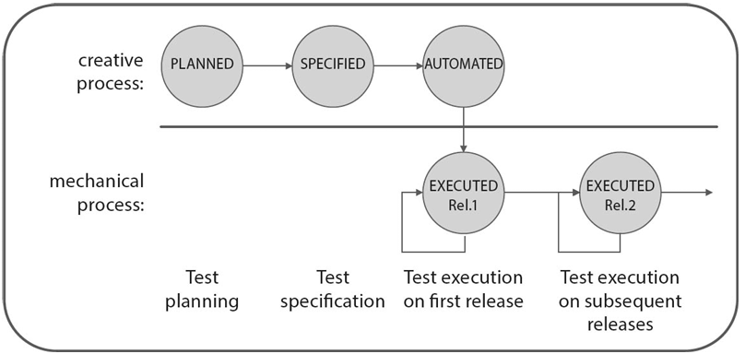
Test case life cycle

Slide 25
Benefits and risks of test automation
Cost benefit analysis
Initial cost > manual test
Savings begin after some automated runs
Useful when regression testing is frequent
Improves testing effectiveness
Finds more failures early
Reduces long-term support and maintenance cost
Helps build higher-quality software

Slide 26
Benefits and risks of test automation
Key advantages
Supports creative testing by removing repetitive work
Increases number of test cases without extra effort
Provides objective data on software quality
Risks of introducing automation
Unrealistic expectations of tool capabilities
Tools used where manual testing is more efficient
Incompatibility with existing tools
Open sources project discontinued
Lack of support

Slide 27
Using tools effectively
Start with process, not tools
“Automating chaos just gives faster chaos”
Automate only well-organized test processes
Improve manual testing maturity first
Consider learning curve, productivity may initially drop
Avoid tool introduction during high-stress phases

Slide 28
Tool selection steps
Define requirements and priorities
Research and compile tool candidates
Run demos and trails
Build shortlist
Conduct a proof of concept
Selection criteria:
Compatibility with test object
Staff skill and training required
Integration with existing tools
Platform, vendor support, cost, licensing model
Must mark essential criteria (deal-breakers)

Slide 29
Pilot project
After selecting tool, validate it in real-world project
Gain practical insights and identity gaps
Should be run by a team not involved in tool selection
Identify training needs
Create re-usable test libraries (if test driver/robots used)
Confirm that useful metrics can be collected and reported

Slide 30
Rolling out the tool
Perform gradual rollout
Embed tools into core processes
Provide training and coaching
Create and share guidelines
Continuously collect feedback and measure tool adoption
Tools are only effective when:
Properly selected
Gradually adopted
Backed by structured processes and support

Slide 31
conclusion
For each phase in the testing process, tools are available to help testers perform their work more efficiently, reliably, or at a higher quality level. Some tasks, such as load and performance testing, can only be performed satisfactorily with tool-based support
Component and integration testing tools are squarely aimed at developers. These include unit test frameworks, test-driven development (TDD) frameworks, continuous integration (CI) tools, static analysis tools, and dynamic analysis (code coverage) tools
Test tools only provide benefits if the testing process itself is mastered and runs in a well-defined manner

